Slide 1
Static Modeling: Problem Domain & System Context
COMP 3700: Modeling and Design
Thursday, February 9, 2017
Gomaa, 2011

Slide 2
Quick Check-In
What are the 3 steps to constructing use cases?
What are the parts of the use case model?
What is/are the relationships between those parts?
Alter Student Grade
<<includes>>
Record Grades for a Section
Teacher

Slide 3

How to construct Use Cases: First, identify actors
Who or what will provide input to the system?
Who or what will need output from the system?

Slide 4
How to construct use cases: Next, identify user goals
User Goals are statements that represent what the users need to accomplish, independent of specific software features
“Buy a book”
“Return a book”
“View order history”
“Record a log for a
transaction”
http://destineemccaskill.com/goals/

Slide 5
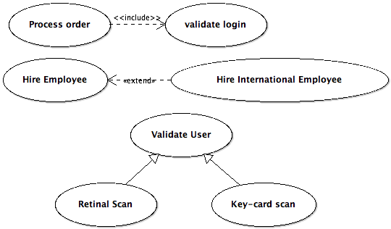
How to construct use cases: Finally, add relationships
Three types of relationships for use cases:
Includes
Extends
Generalization

Slide 6
Activity Diagrams
A UML diagram depicting the flow of control and sequencing among activities
Shows:
Sequence of activities
Decision nodes
Loops
Concurrent activities
A use case model can also be described using an activity diagram
Can be used to represent the sequential steps of a use case including the main sequence and all the alternative sequences
Provides a more precise description of the use case
Shows exactly where in the sequence and what the condition is for an alternative sequence to diverge from the main sequence

Slide 7
Activity Diagrams: Make Order Request

Slide 8
Participation Activity 2: Activity Diagrams
Working in the same groups that you were in for Preparation Activity 2b, represent the use case diagram your group created for Preparation Activity 2b as an activity diagram. Be sure to use activity nodes, decision nodes, arcs to join sequential activity nodes, and loops in your activity diagram.
As you create your activity diagram, you may notice errors or additions that need to be made in your use case diagram and description. Please correct those errors and make those additions.
Upload the following deliverables in Canvas:
Activity diagrams
Updated Use case diagram
Updated use case descriptions
Print out your updated use case diagram, updated use case descriptions, and activity diagrams and bring them with you to class on Tuesday, February 2nd

Slide 9
Participation Activity 3: Peer Review
During this activity, you will exchange your use case model deliverables (described in Participation Activity 2/Preparation Activity 3) with another group in the class, and you will give each other feedback.
In particular, you should assess whether:
the actors identified in the use case diagram are appropriate and whether they are named, and identified as primary or secondary
the use cases are complete and enclosed within a system box
the relationships between the use cases are complete and correctly depicted in the use case diagram
a use case description exists for each use case in the use case diagram
the use case description follows the template and is complete
an activity diagram exists for each use case in the use case diagram
the activity diagram aligns with the use case description in terms of flow (both main flow and alternative flows)

Slide 10
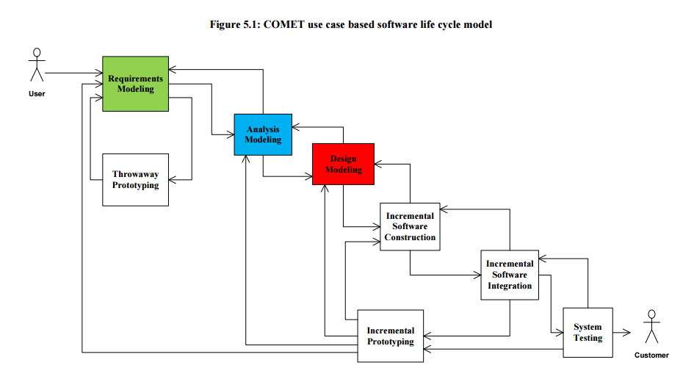
COMET Use Case Based Software Life Cycle Model

Slide 11
COMET Use Case Based Software Life Cycle Model
Develop Software Requirements Model
Develop Use Case Model (Chapter 6)
Develop Software Analysis Model
Develop Static model of problem domain (Chapter 7)*
Structure system into objects (Chapter 8)
Develop statecharts for state dependent objects (Chapter 10)
Develop object interaction diagrams for each use case (Chapter 9, 11)

Slide 12
Static Modeling
Represents the static structure of system
Based on information (Entity-Relationship modeling)
Static Modeling
In object-oriented (OO) Analysis Modeling
Defines classes in system
Defines attributes of classes
Defines relationships between classes
In OO Design Modeling
Defines operations of each class

Slide 13
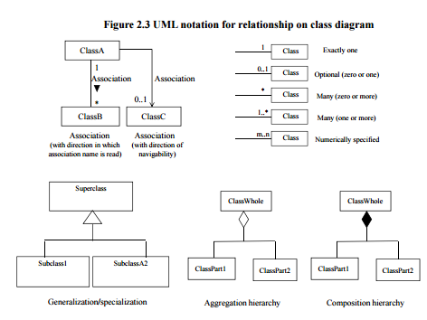
Static Modeling
Defines structural relationships between classes
Depict classes and their relationships on class diagrams
Relationships between classes
Associations
Composition/Aggregation
Generalization/Specialization
Static Modeling during Analysis
System Context Class Diagram**
Depict external classes and system boundary
Static Modeling of Entity classes
Persistent classes that store data

Slide 14
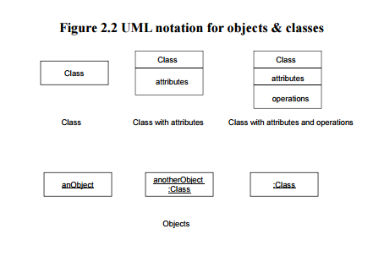
Design Concepts – Objects and Classes
Objects represent “things” in real world
Provide an understanding of the real world
Form the basis for a computer solution
An object (object instance) is a single “thing”
For example: an account, an employee
A class (object class) is a collection of objects with the same characteristics
For example: account, employee
Attribute is a data value held by object in class
For example: account number, balance

Slide 15
Associations
Association is
Static, structural relationship between classes
For example: Employee works in Department
Multiplicity of Associations
Specifies how many instances of one class may relate to a single instance of another class
1-1 association (Company has President)
1 – many association (Bank manages Account)
Numerically specified association (Car has 2,4 Door)
Optional association (0 or 1 – Customer owns Debit Card)
Optional association (0, 1, or many – Customer owns Credit Card)
Many-to-many association (Course has Student or Student attends Course)

Slide 16
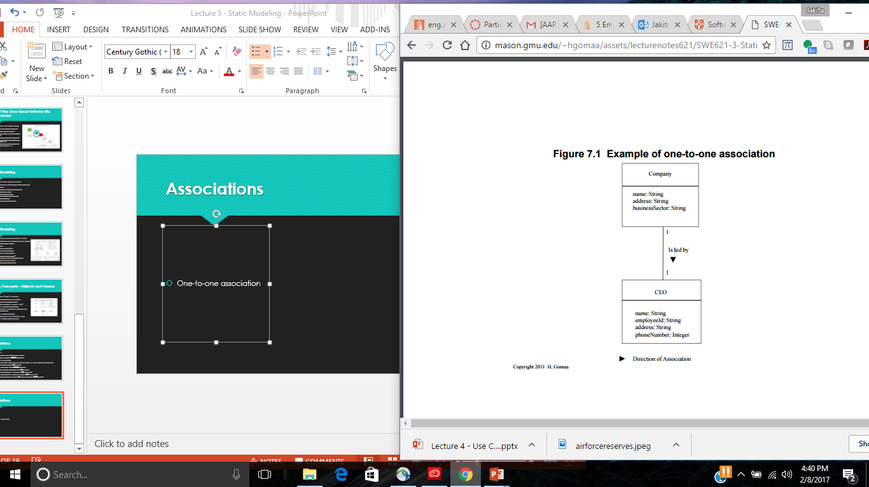
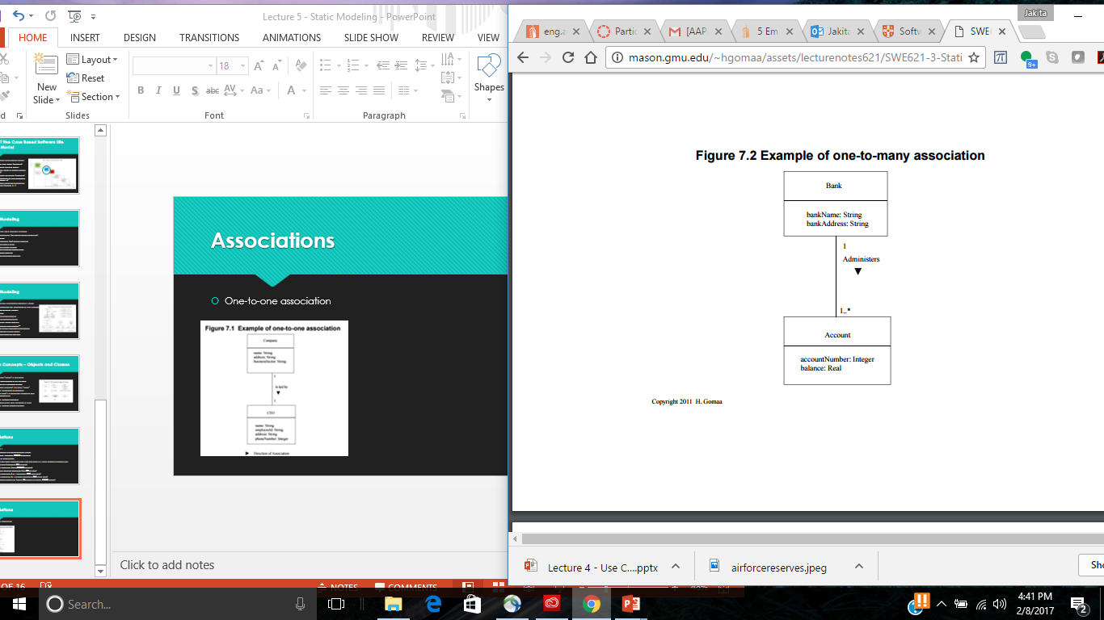
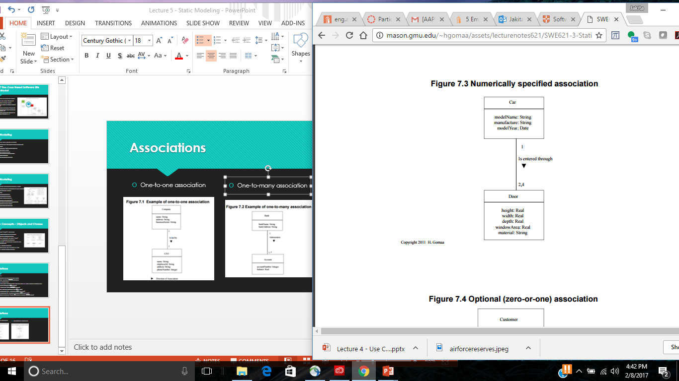
Associations
One-to-one association
One-to-many association
Numerical specified association

Slide 17
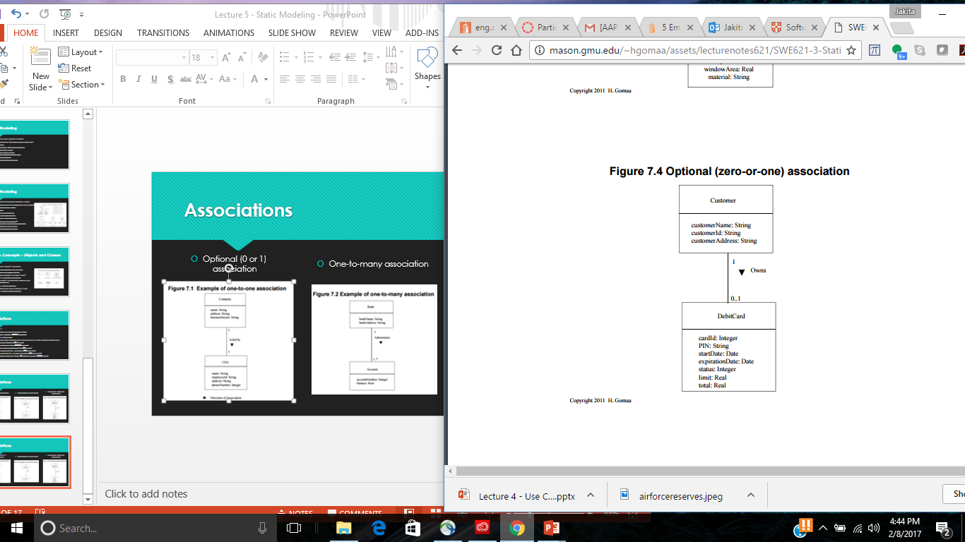
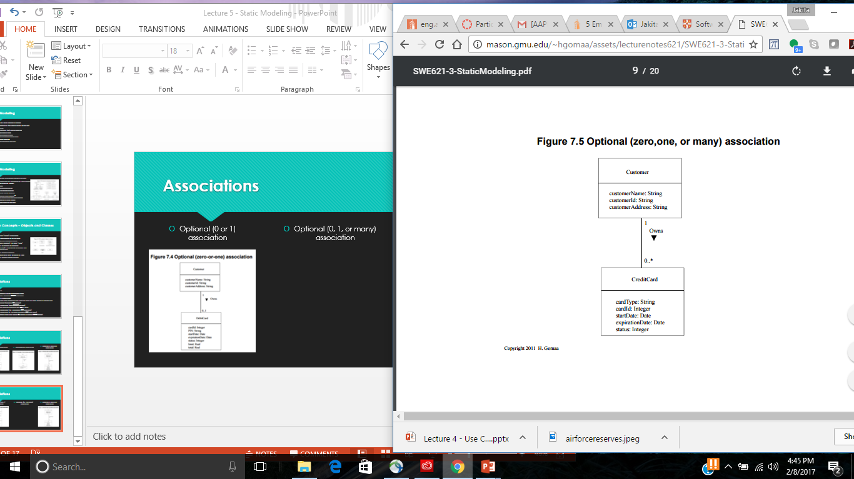
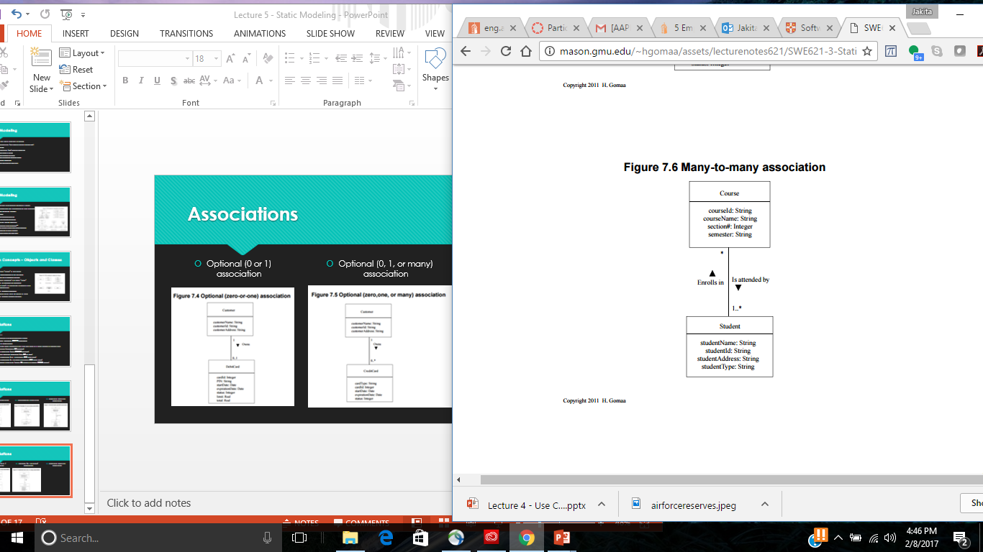
Associations
Optional (0 or 1) association
Optional (0, 1, or many) association
Numerical specified association

Slide 18
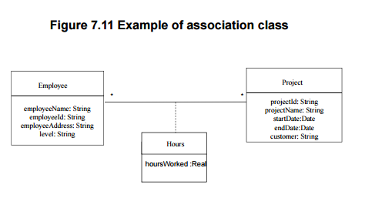
Association Class
Class to model association between two or more classes
Usually for many-to-many associations
Attributes of Association Class
Attributes of association
For example: Many-to-many association between
Project and Employee classes
Project has Employee
Employee works on Project
Association Class – Hours
Attribute – Hours Worked

Slide 19
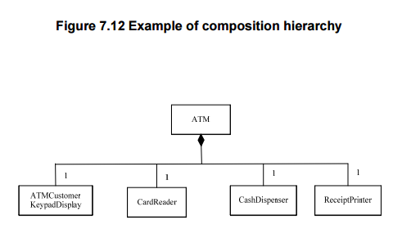
Composition/Aggregation Hierarchy
Whole/Part Relationships
Show parts of more complex class
IS PART OF Relationship
Between part classes and whole (composite or aggregate class)
Composition is stronger relationship than aggregation
Composition Hierarchy
Whole and part objects are created, live, die together
Often also has a physical association
Association between instances
For example: Composite class – ATM (Part Classes)

Slide 20
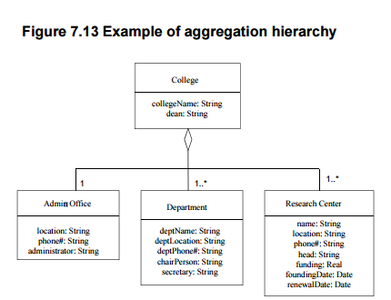
Composition/Aggregation Hierarchy
Aggregation Hierarchy
Part objects of aggregate object may be created and deleted independently of aggregate object
For example: Aggregate class – College
Part classes
Admin Office IS PART OF College
Department IS PART OF College
Research Center IS PART OF College

Slide 21
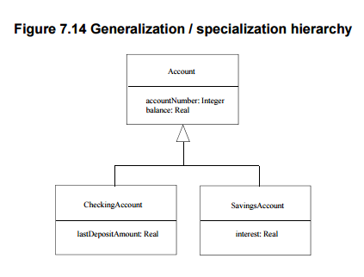
Generalization / Specialization Hierarchy
Some classes are similar but not identical
Have some attributes in common, others different
Common attributes abstracted into generalized class (superclass)
For example: Account (Account number, Balance)
Different attributes are properties of specialized class (subclass)
For example: Savings Account (Interest)
IS A relationship between subclass and superclass
Savings Account IS A Account

Slide 22
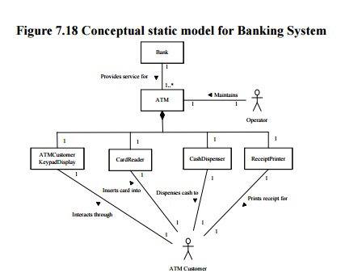
Static Modeling of Problem Domain
During Analysis Modeling
Conceptual static model
Emphasizes real-world classes in the problem domain
Does not initially address software classes
Emphasis on
Physical classes*
Have physical characteristics (can see, touch, etc.)
Entity classes
Data intensive classes

Slide 23
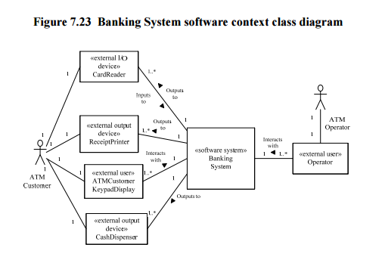
Software System Context Class Diagram
Defines boundary between system and external environment
May be depicted on Software System Context Class Diagram
System
Depicted as one aggregate <<software system>> class
External environment
External classes that software system interfaces to
Categories of external classes (stereotypes)
<<external I/O device>>
<<external user>>
<<external system>>
<<external timer>>

Slide 24
Associations on Software System Context Class Diagram
Software System Context Class Diagram shows
Association between software system and external class
Multiplicity of association (1 to 1, 1..* to 1, etc.)
Associations have standard names
<<external input device>> Inputs to <<software system>>
<<software system>> Outputs to <<external output device>>
<<external user>> Interacts with <<software system>>
<<external system>> Communicates with <<software system>>
<<external time>> Signals <<software system>>

Slide 25
Steps for Designing Static Model
Construct the conceptual static model for the system
Build the hardware/software system context class diagram
Build the software system context class diagram
Add the external class stereotypes to the system software context class diagram

Slide 26
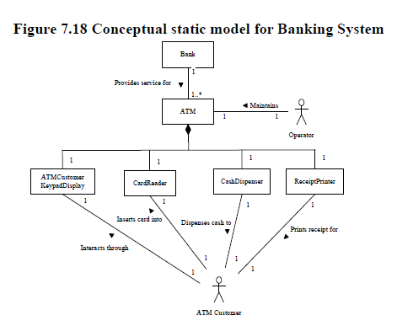
Steps for Designing Static Model
From the problem description and use case model (i.e., use case diagram, use case descriptions, and use case activity diagrams), construct the conceptual static model for the system
Identify physical classes (i.e, classes that can be seen and touched – devices, sensors, etc.)
Identify the associations between the actors, physical classes, and software system (verb descriptions on the lines between those entities)
Describe/depict the hierarchies (composition/aggregation/generalization/specialization)
Describe multiplicity of Associations

Slide 27
Steps for Designing Static Model
From the conceptual static model, build different views into the system through the context class diagram
Build the hardware/software system context class diagram
Depict the hardware/software system as an aggregate class (i.e., black box) with the stereotype <<system>>
Depict the primary and secondary actors
Identify the associations between the actors and the hardware/software system depicted as a black box (verb descriptions on the lines between those entities)
Describe multiplicity of Associations

Slide 28
Steps for Designing Static Model
From the hardware/software system context class diagram
Build the software system context class diagram
Depict the software system (only) as an aggregate class (i.e., black box)
Depict the associations between the actors, physical classes, and software system (verb descriptions on the lines between those entities)
Depict the multiplicity of Associations

Slide 29
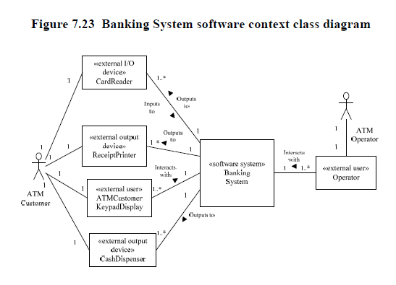
Steps for Designing Static Model
Add the external class stereotypes to the system software context class diagram
Use the stereotype classification on page 108 in your text

Slide 30
Participation Activity 4 & Preparation Activity 5: In-Class Static Modeling Exercise
Working in the same in-class groups, follow the four step algorithm for creating a software context class diagram with stereotypes for the Shelby County Bill Pay system you’ve been modeling
Upload the group’s conceptual static model and software context class diagram with stereotypes in Canvas
Be sure that at least one member of your group brings copies of the conceptual static model and software context class diagram to class on Tuesday.
Additionally, ensure that at least one member of your group brings the latest version of your group’s use case model (i.e., use case diagram, use case descriptions, and activity diagrams) to class on Tuesday.
On Tuesday, you will peer review each other’s conceptual static models and software context class diagrams with stereotypes

Slide 31
Shelby County Bill Pay Problem Description
The website shall allow users to view all of their bills with Shelby County (such as trash bills, water bills property taxes due, and parking tickets). A bill is expected to be paid on time, but there should be a mechanism to pay a late bill as well. To pay a bill, the user can choose the method (card, online check, or bank draft), the payment date, and the amount of the bill to pay. The user can view their current and past bills. Each evening, the system will interact with an external database that is able to process the daily payment transactions. This database interacts with the credit card companies and banks directly to process the payments.
Before viewing or paying any bills, the user must authenticate with the system by providing their username and password. If they don’t have these credentials, there will be an option on the homepage to create an account. Otherwise, once the user successfully logs in, they are able to view all of their bills and select to pay one or more bills.

